Slide 1
Crime Stoppers
Notes:
Speaker: Elias

Slide 2
TABLE OF CONTENTS
01
02
03
04
INTRODUCTION
DALLAS DATA
How are we going to assess and analyze this dataset?
What trends can we find in our Dallas data?
COMPARISONS
FUTURE WORK
How is Dallas similar or different to San Jose?
Where could we expand or investigate further?
Notes:
Speaker: Elias

Slide 3
01
INTRODUCTION
Notes:
Speaker: Elias

Slide 4

DATASETS
& QUESTIONS
SAFETY IS IMPORTANT
Our aim with this dataset is to draw insight from previous arrests to find trends, patterns, and lack thereof
Two Datasets:
Dallas Arrest Dataset:
- 61656 observations
- 2014-2021 data
San Jose Arrest Dataset:
- 153434 observations
- 2015-2020 data
Common Data:
- Arrestee Age
- Arrestee Race
- Arrestee Gender
- Weapon Status
- Drug Status
- Time of Arrest
Notes:
Speaker: Kareem (safety), then Onkar (datasets)

Slide 5

Driving
Questions
- How do drugs affect weaponized crimes?
- Are there any correlations between Dallas’s criminals, crimes, or times?
- Any relations between Dallas and San Jose?
- Any HOLES?
Notes:
Speaker: Elias

Slide 6

02
DALLAS
DATA
What are the trends, patterns and lack thereof?
Notes:
Speaker: Kareem

Slide 7

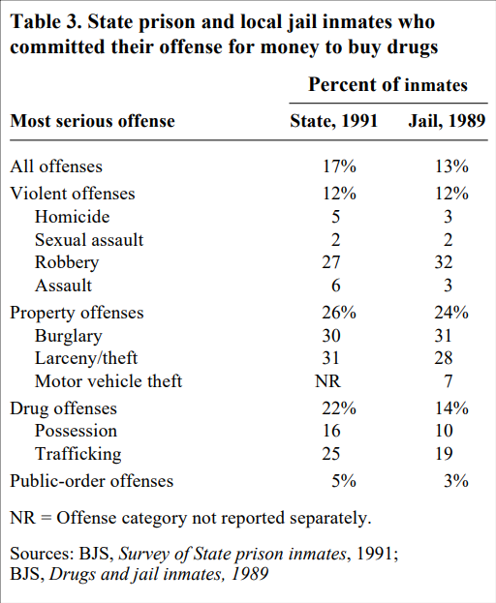
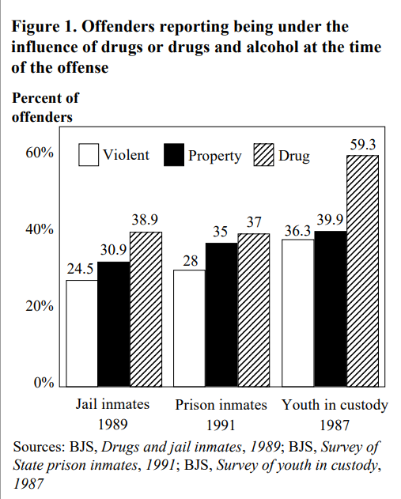
Weapons vs Drugs
Notes:
Speaker: Kareem

Slide 8
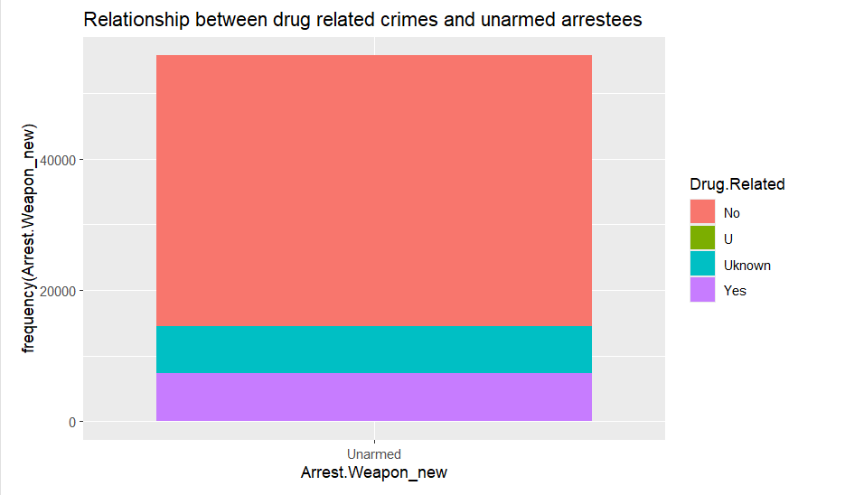
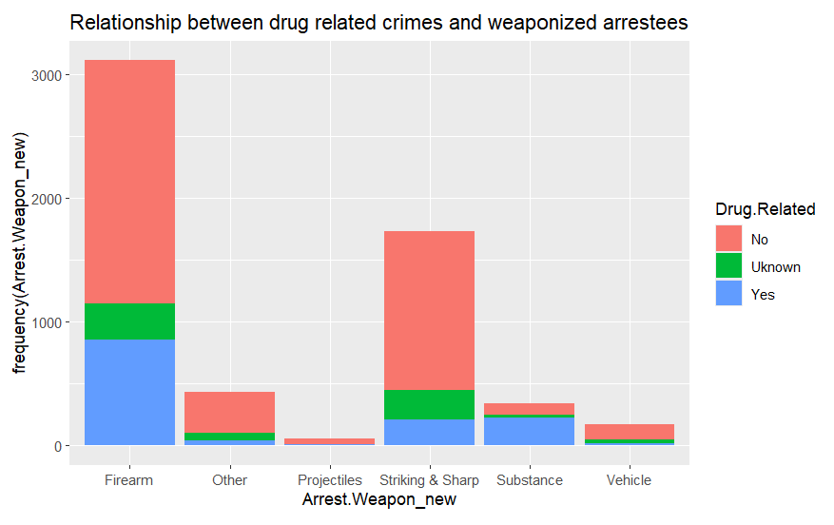
Weapons vs Drugs
Most armed crimes were related to firearm
and unrelated to drugs
Approximately 25% of fire armed criminals committed drug related crimes
We expected a greater fraction of armed crimes to be drug related according to our research
Study by American Addiction center
Notes:
Speaker: Kareem

Slide 9

03
DALLAS vs SAN JOSE
How do trends compare or differ between cities?
Notes:
Speaker: Onkar

Slide 10
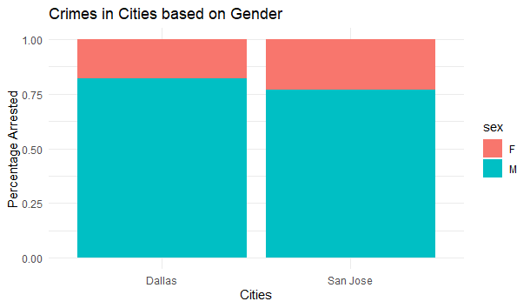
Crime Vs Gender
The male and female population in both Dallas and San Jose are close to even.
In spite of this, males make up 83% of the arrests in Dallas and 77% of the arrests in San Jose.
It is 4 times more likely for a male to be involved in an arrest then a female
Notes:
Speaker: Onkar

Slide 11
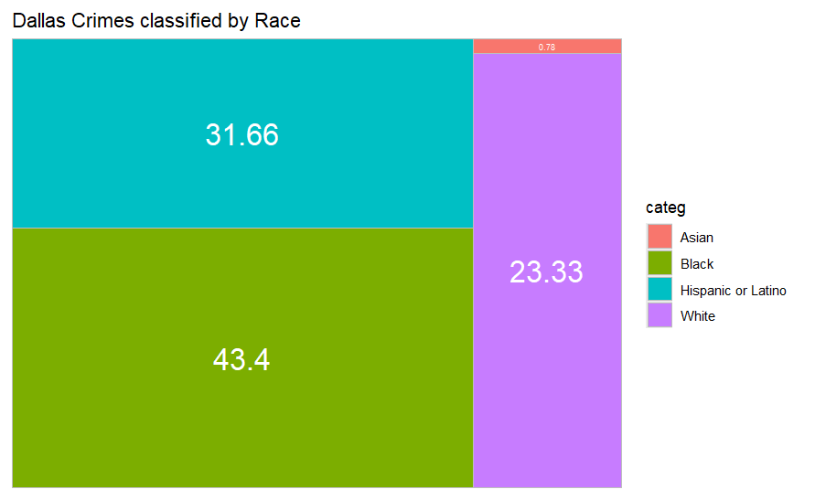
Dallas vs Race
According to the US census Bureau, 23.6% of Dallas citizens belong to the black race, while Hispanic race constitutes 42.40%
Black race accounts for 43.40% of the crimes
Asian race accounts for 0.78% of the crimes
Constitute only 6.7% of Dallas’ population
Notes:
Speaker: Kareem

Slide 12
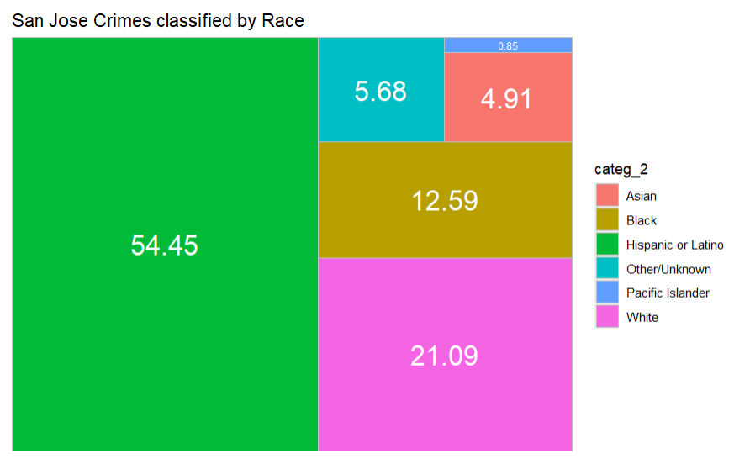
San Jose vs Race
According to the US census Bureau, 30.80% of San Jose citizens belong to the Hispanic race. San Jose’s population is only 2.90% black.
Hispanic/Latino race accounts for 54.45% of the crimes
Pacific Islander race accounts for 0.85% of the crimes
Constitute only 0.50% of San Jose’s population
Notes:
Speaker: Kareem

Slide 13
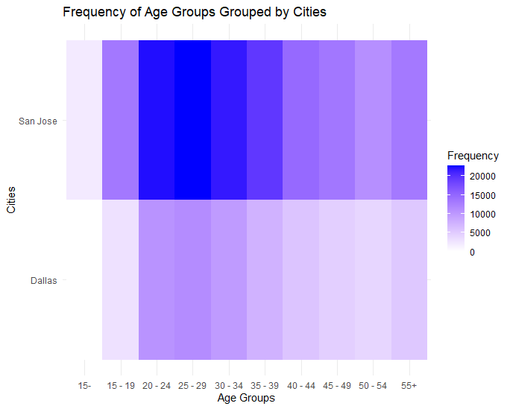
DALLAS AGE
vs SAN JOSE
Most able?
Most needy?
For both, most arrests were for 20-mid 30 year olds
Notes:
Speaker: Elias

Slide 14

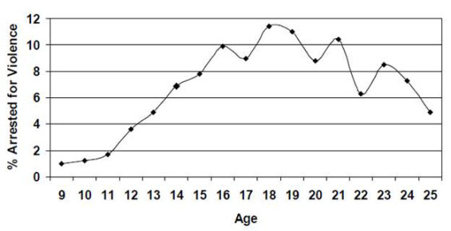
AGE-CRIME CURVE
Crime rises in adolescence, peaks in early 20’s, then falls in the 30’s
But WHY? More investigation and data is necessary
Notes:
Speaker: Elias

Slide 15
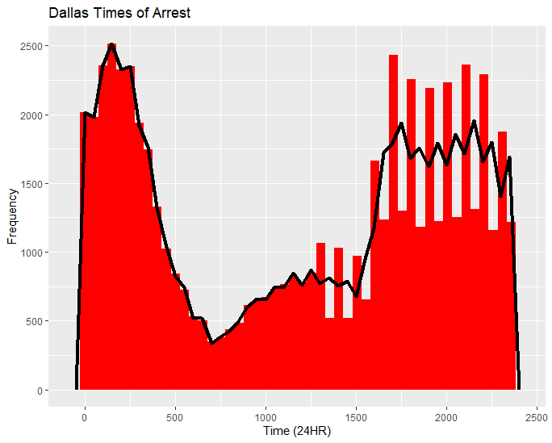
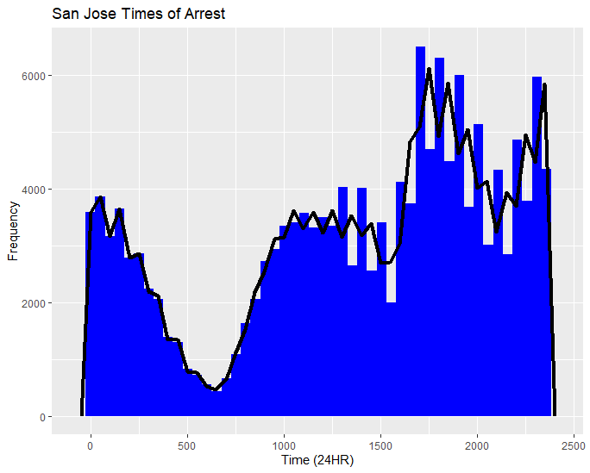
DALLAS TIME vs SAN JOSE
ARREST TIME DOES NOT EQUAL CRIME TIME
Arrests are made most at night
easiest time to commit crime undetected
or police know this, increasing patrols
Arrests are made least near sunrise
people start to wake up, stopping night heists
or cops are switching/ending shifts
We’ll need to investigate this further
Notes:
Speaker: Elias

Slide 16
04
FUTURE WORKS
Considering our analyses and results, where could we go from here?
Notes:
Speaker: Onkar

Slide 17

WHERE TO GO?
Our initial assumption was flawed; there was no significant relationship between drug usage and weapon usage
To improve the safety of Dallas, firearm control would be much more impactful than drug control
One observation from this is that arrests are not typically made early in the morning
It would be important to find a way to address as night time crimes are not being caught after they are committed
Notes:
Speaker: Onkar

Slide 18
References
https://www.census.gov/quickfacts/fact/table/sanjosecitycalifornia/PST045223
https://www.kaggle.com/datasets/aaronnichowilliams/dallas-police-activity
https://www.kaggle.com/datasets/jsherman256/sjpd-incidents-arrests-charges
https://bjs.ojp.gov/content/pub/pdf/DRRC.PDF
https://americanaddictioncenters.org/rehab-guide/addiction-and-violence
https://nij.ojp.gov/topics/articles/youth-justice-involvement-young-adult-offending

